Slide 1
Presentation for each of the RDBMS and their functionalities
Directed by : Yassin Kaabi

Slide 2
What is MySQL?
MySQL is a relational database management system (RDBMS) based on the SQL (Structured Query Language) queries. It is one of the most popular languages for accessing and managing the records in the table. MySQL is open-source and free software under the GNU license. Oracle Company supports it.
The following are the most important features of MySQL:
Easy to use
It is secure
Client/ Server Architecture
Free to download
It is scalable
Speed
High Flexibility
Memory efficiency
High Performance
Platform Independent
High Productivity
Dual Password Support

Slide 3
What is MS SQL Server?
MS SQL Server is RDBMS database software, which is developed and marketed by Microsoft Corporation. The primary goal of this software is to store, retrieve, and access data requested by the developer from the same system or using the remote location. It is introduced for competing with the MySQL and Oracle database software. Similar to other RDBMS, it also uses SQL queries to interact with the databases.
Their functionality :
The primary goal of this software is to store, retrieve, and access data requested by the developer from the same system or using the remote location. It is introduced for competing with the MySQL and Oracle database software. Similar to other RDBMS, it also uses SQL queries to interact with the databases. However, MS SQL comes with its own query language known as T-SQL(Transact-SQL) that provides an additional set of programming constructs for declaring a variable, stored procedure, exceptional handling, etc. It uses SQL Server Management Studio(SSMS) interface tool that supports both 32-bit and 64-bit environments.

Slide 4
PostgreSQL
PostgreSQL is an open-source, cross-platform, and object-relational database management system (ORDBMS) built in the computer science department, University of California.
Their functionality :
It provides a very easy setup and installation. It has supported both SQL and NoSQL query languages. It offers data to store securely and can recover whenever the request is processed. It is ACID-compliant, highly concurrent, and also supports functions, stored procedures & triggers. It has MVCC (multi-version concurrency control) that allows several users to work on the system at once.

Slide 5
Comparison between PostgreSQL vs MySQL
The following are some points that make PostgreSQL more favorable than MySQL:
PostgreSQL is a very secure, independent, and feature-rich open-source database.
PostgreSQL supports a lot of advanced data types like multi-dimensional arrays, user-defined types, etc.
PostgreSQL follows the SQL standards very well and supports "advanced" SQL stuff like window functions or common table expressions.
It provides all performance optimization that is supported in Oracle and SQL Server.
PostgreSQL is using by companies like Amazon, Redshift, Instagram, etc.
The following are some points that make MySQL more favorable than PostgreSQL:
MySQL is more popular than PostgreSQL in terms of DB ranking.
Getting community support and search answers is easier in MySQL than PostgreSQL.
Replication is well implemented in MySQL rather than PostgreSQL.
MySQL is using by companies like Facebook, Twitter, Pinterest, etc.

Slide 6
Comparison between MySQL and MS SQL Server
The following are the essential comparisons between both of them:
Environment: MySQL is managed and supported by Oracle Company that can work with most of the popular operating systems. It can also work with other languages like TCL, Scheme, Perl, and Haskel. On the other hand, MS SQL is managed and supported by Microsoft Company that mainly runs on the Windows operating system.
Editions: MySQL database comes in three editions that are MySQL Community Edition, MySQL Enterprise Edition, and MySQL Standard Edition. In contrast, the MS SQL database is available in multiple variations like Standard, Enterprise, Web, Workgroup, or Express editions.
Language Compatibility: In the MySQL database system, we can use various programming languages such as C, C++, Ada, Perl, Java, etc. Whereas in MS SQL, we can use .Net, PHP, Ruby, Visual Basic, Java, VB, and Python programming languages. The following image explains it more clearly:

Slide 7
Security: MySQL uses EC2 compliant services to store the data securely. Whereas MS SQL Server has EC2 compliant along with state-of-the-art security features, and Microsoft Company itself privately owns this feature.
Filtering: MySQL filters out users, tables, rows, etc. in many ways, but it can work with only a single database at one time. On the other hand, MS SQL can work with more than one database at the same time. MS SQL allows developers to filter out users, tables, rows, etc. on one database and can store the filtered data in a different database.
IDE Tools: MySQL and MS SQL always use different IDE tools for development. MS SQL uses SQL Server Management Studio (SSMS) interface tool. While MySQL uses Enterprise Manager that allows us to connect with the server and provides database management for architecture, table design, and security.

Slide 8
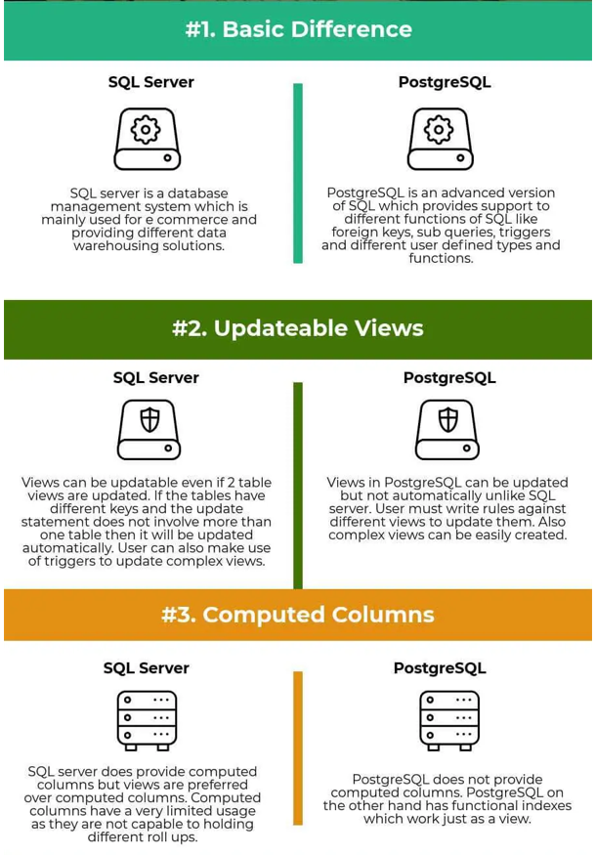
Comparison between SQL Server vs PostgreSQL

Slide 9
